Slide 1
September 2025 Executive Data Board
Virginia Office of Data Governance and Analytics
September 23rd, 2025

Slide 2
Agenda
Time | Topic
1:00 PM-1:10 PM | Welcome, Order of Business
1:10 PM | ODGA Updates
2:15 PM | Break
2:20 PM | Agency Updates
3:00 PM | ODGA Events, Member and Public Comment, Adjourn

Slide 3
Executive Data Board
Translate the Commonwealth's data-driven policy goals and objectives into performance targets at their respective agencies.​
Allocate appropriate resources at their respective agencies to support data governance, sharing, and analytics initiatives.​
Provide any reports to the Office of Data Governance and Analytics regarding their respective agencies' data analytics work and implementation of recommendations.​
Related legislation: https://lis.virginia.gov/cgi-bin/legp604.exe?212+ful+CHAP0314
Purpose
Drive the Commonwealth’s data-driven policy goals and objectives at their respective agencies in partnership with the Office of Data Governance and Analytics

Slide 4
Meeting Goals
Approve meeting minutes
Vote on expanding membership
Share ODGA updates with agency staff after the meeting
Share agency Data & Analytics projects with Deputy CDO

Slide 5
Orders of Business
Roll Call
Approve March 2025 meeting minutes
Expand the membership in the Executive Data Board
  Currently 8 members plus CDO
  34 Executive branch agencies belong to the Commonwealth Data Trust
  Propose expanding EDB membership to 15 members including CDO to include at least one member of each Secretariat
    Suggested agencies: VITA, DOAV, TRS, DOLI, DJJ, VDFP, DVS, DOF, VEDP.
    Better representation across executive agencies
    Expands Data Governance Council
    Quorum requires 8 attendees
Approve revised charter to reflect membership change

Slide 6
Executive Agency Data Trust Status
Administration | Agriculture | Commerce | Education |  | Finance | Health & HR | Labor | Natural Resources | Public Safety | Transportation | Veterans
CB DGS DHRM ELECT VITA ODGA* | DOF VDACS VRC | DHCD DSBSD ENERGY TRRC VEDP VIPC VTA | CNU DOE* EVMS FCMV GH GMU IALR JMU JYF LVA LWU NCI NSU ODU RBC RHEA RU | SCHEV SMV SVHEC SWHEC UMW UVA VCA VCCS VCU VIMS VMFA VMI VMNH VSDB VSU VT WM | BOA DOA DPB TAX TRS VRA | ATLFA CCCA CH CSH CVTC DARS DBHDS* DBVI DHP DMAS* DSS* ESH HDMC NVMHI OCS PGH SEVTC SVMHI SWVMHI VBPD VCBR VDDHH VDH* VFHY VRCBVI WSH WWRC | DOLI DPOR VEC* | DCR* DEQ DHR DWR MRC | CASC DCJS DFP DFS DJJ DOC VDEM VPB VSP* | DMV DOAV DRPT MVDB OIPI VAP3 VCSFA VDOT VPA VPRA | DMA DVS VSF
Other Members
Virginia 529
DCLS
HSD
JCHC
OMNI Institute
VARR
VHHA
CTO
G H International
Qlarion
Rappahannock CSB
Chesapeake PD
Chesterfield PD
Danville PD
Emporia PD
Hampton PD
Hopewell PD
Lynchburg PD
Martinsville PD
Newport News PD
Norfolk PD
Petersburg PD
Portsmouth PD
Richmond PD
Roanoke PD
Virginia Beach PD
*= Executive Data Board Members

Slide 7
ODGA Updates

Slide 8
Data Strategy – Key Focus areas for the ODGA
Data Sharing
  Safe and secure data sharing via the Commonwealth Data Trust
Data Governance and Compliance
  Data Privacy (GDCDPA compliance)
  Risk Management (security protocols, data classification)
  Data Ownership & Stewardship (roles, accountability)
  Data Lineage & Auditing
Data Architecture & Infrastructure
  Cloud-First Strategy
  Scalable Data Lakes and Warehouses
  Real-Time Data Integration
  API-Driven Data Ecosystem
Data Quality & Integrity
  Data Validation & Cleaning Tools
  Monitoring & Data Quality Dashboards
  Data Consistency & Accuracy Metrics

Slide 9
Data Strategy – Key Focus areas for the ODGA (cont'd)
Data Literacy & Culture
  Data Education Programs (trainings, certifications)
  Cross-Departmental Data Collaboration
  Building Data-Driven Teams & Leadership
Advanced Analytics & AI
  Predictive Analytics & Machine Learning Models
  Automated Reporting Dashboards
  Data-Driven Decision-Making Tools

Slide 10
ODGA Technology Stack: Databases
Azure Synapse Data Warehouses
  Hosting 12 production-level data warehouses, each exclusively supporting a specific agency.
Azure SQL Databases
  20 databases primarily serving as data marts.
  Designed to deliver specific datasets outlined in project-specific Memorandums of Understanding (MOUs).
  Access is role-based and limited to users specified within each MOU.
Azure SQL Managed Instance
  Deployed across both production and non-production environments.
  Hosts internal ODGA databases, including the Commonwealth Data Trust, ETL Logging, Maturity Assessment, and other internal systems.

Slide 11
ODGA Technology Stack: ETL Tools
Azure Synapse Analytics
  Used for data integration, transformation, and orchestration within the Azure environment.
Python
  Utilized with Spark pools in Azure for data processing.
  Also used for making API calls to services such as Microsoft Purview, Power BI, and the Open Data Portal, among others.
Databricks (Proof of Concept Phase)

Slide 12
ODGA Technology Stack: Other
Unstructured Data Storage
  Azure Data Lake Storage (ADLS)
  Consists of 4 distinct instances acting as landing zones or drop-off points for file-based data.
  Supports both data ingestion and sharing.
  Access is highly restricted and governed by the terms of corresponding MOUs.
Object-Oriented Programming
  Utilizes .NET and Angular frameworks within the Azure environment.
  Development projects include the Commonwealth Data Trust and the SUDA Portal.
Data Visualization
  Power BI Service (Capacity Level 1)
  A cloud-based analytics platform enabling ODGA to create, share, collaborate on, and distribute interactive reports and dashboards across agencies.
  Currently supports:
    20 Production Workspaces
    11 Production Apps
Microsoft Purview
  The Data Governance team manages a dedicated Microsoft Purview instance that maintains all metadata related to ODGA-managed data, including both internal datasets and agency-specific data assets.

Slide 13
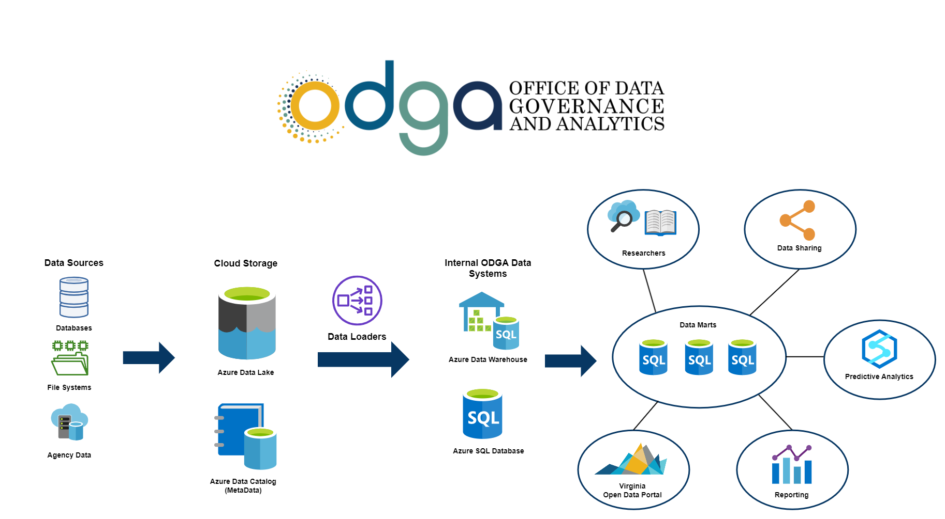
ODGA Data Ingestion Workflow Example

Slide 14
Data Governance and Compliance
Open Data Portal
20,076 datasets
15,995 visits in Aug
New Agencies – TAX, TRS, VSP
389,561 assets
14, 614 glossary terms
Unstructured Data Scanning
49.69M objects scanned
13 executive agencies scanned
45,077 page views
Structured Data Scanning
Data Classification
Sec 540 published
Data Classification Policy and Standard Available
Data Classification Framework ETA Nov 1
Sources Scanned - file shares, OneDrive, Sharepoint, Filenet

Slide 15
Virginia Government Data Collection and Dissemination Practices Act
The Government Data Collection and Dissemination Practices Act (Code of Virginia § 2.2-3800 et seq.) is Virginia's comprehensive privacy law governing how state and local agencies handle personal information.
§ 2.2-203.2:4 “The purpose of the Office shall be to (i) improve compliance with the Government Data Collection and Dissemination Practices Act (§ 2.2-3800 et seq.)”
How is ODGA ensuring compliance?
  Conducted a Web Privacy Policy Audit
  Partnered with VITA team on leveraging Ardoq for Data Inventory
  Building Awareness through Lunch and learns:
    July 2025: 68 Attendees from 24 agencies
    October 2025: Next L&L for agencies (10 registered so far)
    November 2025: L&L for Universities/Colleges (47 registered so far)
    December 2025: L&L for Localities

Slide 16
COVLC trainings- Section 527 requirement
Data Owner Training
How the Commonwealth Data Trust facilitates secure data sharing across the Commonwealth
Options for sharing data with other agencies and the public depending on the sensitivity of data or intended audience
Identify how data is handled at each step of the data lifecycle
Differentiate between key data governance roles
Categorize data using classification tiers
Data Custodian Training
Data Governance roles in the Commonwealth
Data Custodian responsibilities
Available in the COVLC or via SCORM files for agencies!

Slide 17
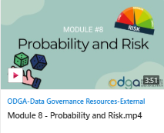
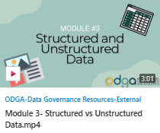
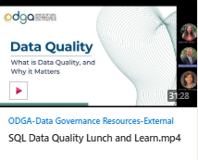
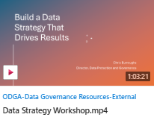
Data governance and literacy site
Data Literacy Videos
  A hub for data literacy concepts, such as:
    Causation versus correlation
    Misleading charts
    And more!
ODGA Lunch and Learn Recordings
Recordings of ODGA Lunch and learn meetings
Want to attend lunch and learns live? See the events page on our website!

Slide 18
Data Literacy
New Videos
Video Library
Data Literacy Foundations
Per Capita
How to Write an Executive Summary
Data Storytelling
Spotting Data Entry Errors
Sampling Methods
Bias in Data Collection
Credibility
Quantitative vs Qualitative
Structured and Unstructured Data
Mean, Median, Mode
Misleading Statistics
Polls and Margin of Error
Correlation vs Causation
Probability and Risk
Boolean Logic
You are the Product
Master the Language of Data Visualizations
Misleading Charts
Data Literacy Library
Available to all COV employees – no VCCC tickets required!
Localities and non-COV employees can request access from ODGA

Slide 19
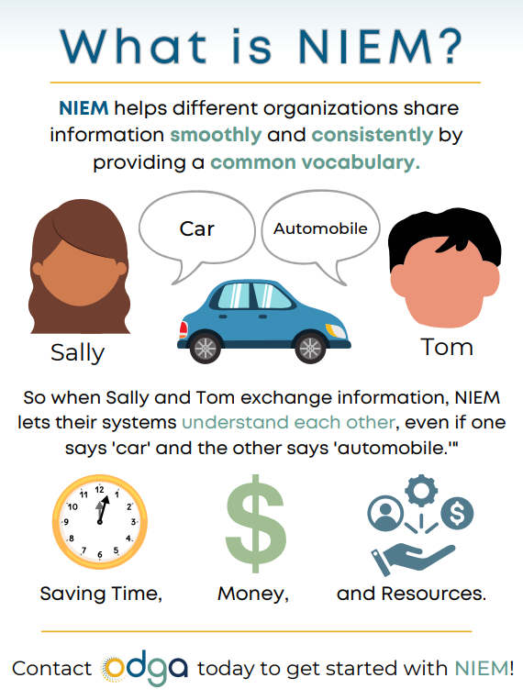
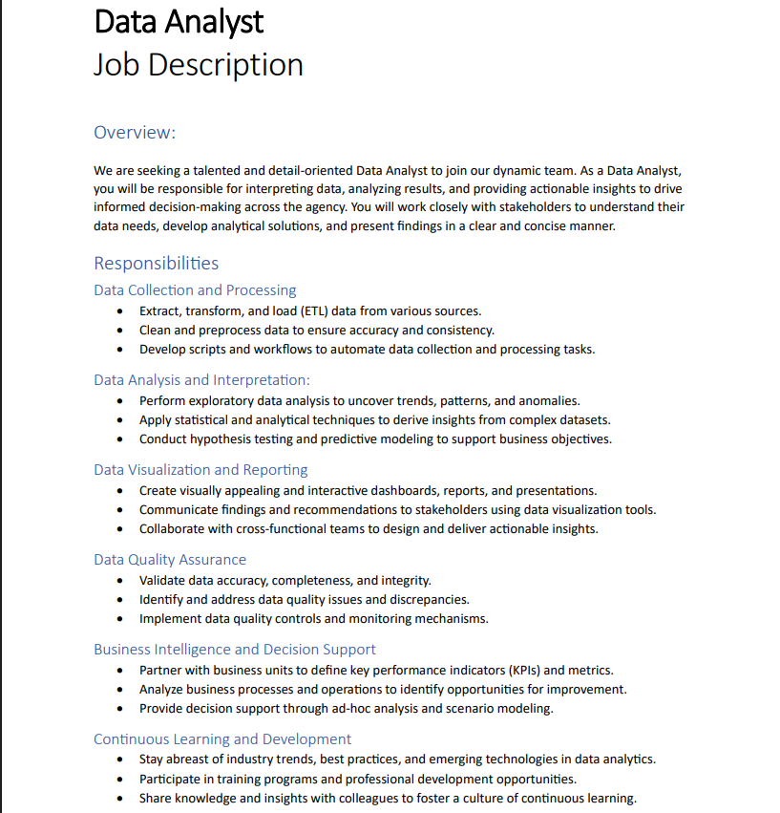
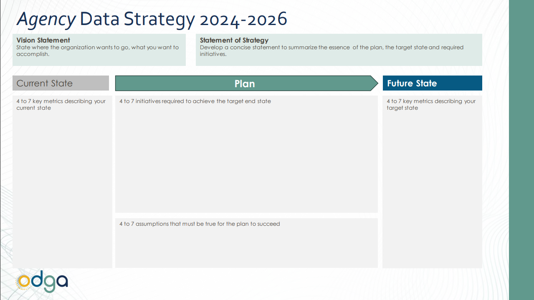
Resource Library
Templates, guidebooks, videos, and job descriptions
Free for agencies to edit and implement into their data governance programs

Slide 20
Break: 5 minutes

Slide 21
Agency Updates

Slide 22

DBHDS
Project Name | Due Date | Status (Not Started, In Progress, Finished) | Comments
Data Governance | 10/30/2025 | In-Progress | 12 policies enacted Data Governance Sustainment Plan drafted Data domain onboarding to ingestion policies continues with 2 domains (7 domains have signed-off) Consumption policy onboardings sign-off completed for Adult Community Behavioral Health (CCS3)
Enterprise Data Warehouse Modernization | 2/27/2026 | In-Progress | Regular EDW releases continue - rel v1.7.0 - target-9/9 Integration of Avatar, VCC and VHI data sources into the EDW continues: VHI to Prod – target 9/19 Avatar / VCC to Prod – target 10/10
Data Exchange/CCS3 Sunset | 8/30/2025 | Finished | Integration completed with all the 40 CSBs (Community Service Boards) in production Receiving and processing HL7 messages from all the CSBs successfully
Revenue Cycle Modernization | 4/17/2026 | Not Started | Contract negotiations have stalled DBHDS leadership to decide strategy during 9/11 Leadership Meeting
Financial Management System replacement – Phase 1 | 12/31/2025 (previous was 8/31/2025) | In-Progress | End user training in progress Cardinal Integration testing in progress, scheduled to be completed by 10/3 Prod environment configuration in progress Change order approved to move go-live to 11/1 and close to 12/31.
SQL Server Update | 6/30/2025 | In- Progress | Impacted servers identified, Dev Server upgrade Proactive enforcement of Data Policy for legacy server
odga.virginia.gov

Slide 23
DMAS Data Projects for Executive Data Board pt 2
Project Name | Due Date | Status (Not Started, In Progress, Finished) | Comments
Develop Agency Data Strategy | March 2025 | Finished | DMAS developed a Data Strategy by building on ODGA’s Lunch and Learn. DMAS’s Data Strategy incorporates ongoing Data Governance work, strengthens the Agency’s understanding and use of data, and improves Business Outcomes.
Communicate and Implement Agency Data Strategy | December 2025 | In Progress | We’ve initiated some projects to improve documentation and consistency around using and accessing data. Encounters data project – Obtain additional data elements from MCO Encounters Data Definitions/Data Catalog project – Develop standard data definitions, code sets, and analytic conventions for DMAS covered services FOIA and External Data Requests – Update and communicate Roles and Responsibilities, Policies, and Procedures Identify data needs within DMAS DG – Ongoing discussions with Security, Analytics, and Business staff
Data Trending | Phase 1: June 2025 Phase 2: December 2025 | Phase 1: Finished Phase 2: In Progress | Phase 1: Develop internal tables and scorecards to track and monitor Program Costs and Utilization trends. Phase 2: Collaborate with internal data and business teams to coordinate efforts to monitoring costs and utilization trends

Slide 24
DMAS Data Projects for Executive Data Board pt 3
Project Name | Due Date | Status (Not Started, In Progress, Finished) | Comments
Migration of SAS to cloud | EO19 | In Progress | To meet Executive Order #19 (which directs the movement of applications servers to the cloud, as well as improve and consolidate existing technologies and security for existing applications), DMAS will transition the SAS VIYA analysis application and accompanying services from a server-based platform to a cloud-based platform.
Medicaid Member Profiles | June 2025 | Finished | Develop graphics and visualizations to represent and describe key groups of Medicaid members to internal and external Stakeholders
VDH data sharing for Cause of Death data | Phase 1: February 2025 Phase 2; Cancelled Phase 3: February 2025 | Phase 1: Finished Phase 2: Cancelled Phase 3: Finished | Many initiatives depend on DMAS's ability to report and analyze Cause of Death data including: mandatory CMS program evaluations, requests from Governor Youngkin, requests from DMAS Agency Director, and requests from other internal DMAS stakeholders. Phase 1- VDH to send Cause of Death data to DMAS for the CMS mandatory evaluation of the Medicaid ARTS program. Phase 2- DMAS to obtain general use permission to use Cause of Death data for other reporting (including Executive Order 26). Phase 3- VDH to send Cause of Death data and Birth data to DMAS for the CMS mandatory evaluation of the Medicaid Postpartum Coverage Extension program
odga.virginia.gov

Slide 25
Virginia State Police Data Projects pt 1
Project Name | Due Date | Status (Not Started, In Progress, Finished) | Comments
VSP Agency-wide Data Assessment and Improvement Campaign | 2025 | In Progress | Internal focus of developing data governance and functionality that allows the transformation of existing and future data into an actionable state. External focus of pursuing a status of data which is translatable to a larger Commonwealth need. In partnership with ODGA. VSP has members in the ODGA Executive Data Board, Data Governance Council, & Data Stewards Group. May 17, 2024 - VSP created internal data governance and data strategy document. December 25, 2024 – VSP brought on board a Chief Information Technology Officer. August 25, 2025 – VSP brought on board a Chief Data Officer.
***Community Policing Act Data | January 2026 | In Progress - Ongoing Obligation – DCJS Annual Report Obligation | Newly released Technical Specification (v6) to include updates required by House Bill 2724 specific to License Plate Reader/Recognition Systems -Data Element Reason for Stop – Addition of L = License Plate Recognition/Reader -New Data Element LPR Notification – Specific to the use of LPR New Goal – Update schema for public repository for CPA data on Open Data Portal
***UCR-IBR Data We are well on our way in the process of creating the new Beyond 2020 Crime Dashboard (Theme Oriented Public Site aka TOPS). Here's a sneak peak of the layout. https://vatest.beyond2020.com/vatest_tops | January 2026 | In Progress – Ongoing Obligation | Theme Oriented Public Site (TOPS) now available for public dashboard of crime data replacing the hardcopy 'Crime In Virginia' publication Newly released Technical Specification (2025.1) to include updates required by both the FBI Program and new legislation. -Data Element 8 – Addition of R = Drone/Unmanned Aircraft System -Data Element 12 – Expansion of required gang information to include additional offenses -New VA Data Element 66 (Special Case Indicator) – Specific to the use of LPR New Goal - Conversion of Virginia agencies to reporting in XML format via webservice from each agency RMS as opposed to the current flat file monthly upload.
***Law Enforcement Suicide Data | December 2025 | In progress - ODGA (Bob Ramos) was planning to collect the data and utilize Keon and team for analysis. Need to collaborate with ODGA. Other priorities have prevented movement. | Implementing a method to collect suicide data for employees (past and current) of the Department to meet goals of the Law Enforcement Suicide Data Collection Act. MOU created and executed with ODGA to share data and learn how to assist agencies with sharing applicable data. Data trust signed by DCJS and VDH. VDH to supply a list of all deaths indicated as suicide with specific fields. That data would be compared with the DCJS list of certified police officers. This comparison would allow for agencies, including VSP, to submit data directly to the FBI Law Enforcement Suicide Data Collection.
Notes:
Law Enforcement Suicide Data – a completed process for capturing attempted suicide information has been implemented with VSP Wellness Coordinator. The completed suicide data is still being reviewed with ODGA based on a data trust to share death information from Public Health and DCJS.

Slide 26
Virginia State Police Data Projects pt 2
Project Name | Due Date | Status (Not Started, In Progress, Finished) | Comments
***Photo Speed Monitoring Data Collection (ODGA not involved) | January 2026 | In Progress (Annual Obligation) | Enhanced collection to add additional speed reduction information. Creation of reporting requirements disseminated to vendors/service providers for receipt of data New Goal: Determine potential for repository to collect row level data provided funding is received. Addendums to report to indicate the general dissemination of funds process (local agencies will have detailed dissemination information)
Surveillance Technology Data Collection (ODGA not involved) | 2025 | In Progress (Annual Obligation) | Pending DCJS requirements, create a standard process to collect data on the procurement and use of surveillance technology.
***Operation Bold Blue Line | Ongoing Initiative | In Progress | Capturing and providing data in dashboard and requested formats to measure effectiveness of program. Receive data from both Central Criminal Records Exchange (CCRE) & Data Analysis and Reporting Team (DART). DART data will include expanded gang information. CCRE continues to work with DART to provide the requested data & formats
***Firearms Transaction Center Report Automation | N/A | Completed | Put into production in December 2024. As of February 7, the system is sending the automated reports via email based on distribution list. This can be removed from project list.

Slide 27
Virginia State Police Data Projects pt 3
Project Name | Due Date | Status (Not Started, In Progress, Finished) | Comments
***Open Data Portal Communications | N/A | Completed | Community Policy Act Data (Contact – Keon Turner) Cold Case Database (Contact – Rob Vance)
***Arrest Data (CJIS provides daily to ODGA) | N/A | Completed | There are multiple feeds of data. DART provides anonymized data (no PII) for offenses and CCRE provides statute-based data. DART IBR data is sent via SFTP monthly and CCRE data is sent daily.
***Commonwealth Data Trust Portal (Data Trust Agreements) | N/A | Completed | Makes review of shared data much easier. VSP leadership can use login to see all the data currently shared with ODGA, based on the data trust agreements. It appears the data currently under the agreement includes both IBR and SOR data.
ODGA Data Management Maturity Assessment | N/A | Completed | VSP completed for 2022, 2023, and 2024.

Slide 28
Virginia State Police Data Projects pt 4
Project Name | Due Date | Status (Not Started, In Progress, Finished) | Comments
Data Asset Inventory for ODGA/COVA Data Catalog | N/A | Completed | Catalog is live now.
Data Governance and Operations related to Human Resources Data – with ODGA | 2025 | In Progress | We had an initial meeting with ODGA to discuss challenges, and we are waiting to hear from them about scheduling more meetings to move forward. Contact: Chris Mowry (Chief Information Technology Officer)
ODGA Data Quality Tool | N/A | In Progress | Early stages of starting Purview scanning. Contacts: VSP Data Warehouse Team (David Crighton)
Big ID Unstructured Data Scanning (Scanning of SharePoint sites) | 2025 | In Progress | ODGA has a tool to scan SharePoint sites to ensure all data is accounted for and to ensure sensitive data is not being stored improperly. Initially gave the DART section a demonstration when it was first introduced, and it was decided this should live with IT and the ISO. Contacts: Stephanie Williams-Hayes (ISO) and Chris Mowry (CITO).

Slide 29
Virginia State Police Data Projects pt 5
Project Name | Due Date | Status (Not Started, In Progress, Finished) | Comments
Executive Order 39 Permitting / Approvals / Certifications - VPT More than 15 days Wait | N/A | Ongoing | Motor Vehicle Safety Inspection Program (MVIP) Station Appointments – Approvals – Reducing Time from process Inspector Certifications – Same Virginia Permit Transparency or other Dashboard (VITA, IT Division)

Slide 30
VEC Data Analytics Projects
Project Name | Due Date | Status (Not Started, In Progress, Finished) | Description
Employee Relations Dashboard – HR Data. | 6/6/2025 | Finished | Tracks the types of concerns raised/addressed, what has been addressed, number of grievances, ADA, etc
Delinquent Accounts Dashboard | 8/15/2025 | Finished | Tracks Total Balance for all Active and Inactive Accounts by week. Helps observe total recovered by agency on week-to-week basis
VEC CHAT BOT | 12/31/2025 | In Progress | Used to assist VEC Customers with commonly asked questions about claims
VEC SHAREPOINT | 9/15/2025 | Finished | Created content for UI Benefits & Payment Charge Unit, Compliance & Integrity, Fraud, Overpayment, and Appeals processes, streamlining staff access to critical forms and guidance.
Resiliency Plan | 11/1/2025 | In Progress | Goal of project is to create a system to detect possible economic concerns and establish plans to address them
Power BI Federal UI Claims Activity | 4/15/2025 | Finished | UI Claims activity, enabling leadership to perform more thorough trend analysis.
Appeals Inventory Worksheet | 12/31/2025 | In Progress | Goal of project is to use historical data to predict new appeal dockets per week

Slide 31
VEC Data Analytics Projects pt 2
Project Name | Due Date | Status (Not Started, In Progress, Finished) | Description
Dashboard for Chief Administrative Officer & HR | 5/15/2025 | Finished | Track productivity of Remote employees
DOGE DASHBOARD - Federal Government UI Claims & White House trends | 8/15/2025 | FINISHED | Project impacts COAs on Federal Employees, specifying outcomes and associated costs to the Commonwealth of Virginia, including UI benefits expenditure and estimated job losses.
UI Claim Data Analysis |  | FINISHED | Analyzed and merged over 5 years of UI Claim data across multiple quarters to support operational reporting in excel and Power BI
DATA REPOSITORY OPS |  | FINISHED | proper record management, enabling trend analysis and improved decision-making in Ops Cycle meetings
VEC Power BI Knowledge Management |  | IN PROGRESS | Developed SOPs for Power BI Dashboards in terms of contingency resiliency plan
HR AUTOMATION FORMS | 11/15/2025 | In Progress | Digitizing all onboarding & offboarding paperwork, to improve accuracy, reporting, and trend analysis
5 year UI CLAIM Data Dashboard | 09/05/2025 | Completed | Analyzed & Consolidated 5 years of UI Claim data, improving the accuracy and depth of operational reporting for management

Slide 32
VEC Data Analytics Projects pt 3
Project Name | Due Date | Status (Not Started, In Progress, Finished) | Description
Data Repository | 8/20/2025 | Finished | Policy and Legal to securely sent classified data to external parties, compliance with secure transfer protocols.
SharePoint Knowledge Management & Training | 11/1/2025 | In Progress | SharePoint Training and KM for VEC, developing SOPs and Info sessions to allow VEC users to fully utilize SharePoint

Slide 33
Data Management Maturity Assessment- October 2025
Given to Commonwealth Data Trust Members
Open to anyone to take- Contact ODGA if interested in October!
24 Questions based on data progress in the following:
  Data Foundation and Governance
  Data Quality and Management
  Technology and Infrastructure
  Data Analytics and Decision Support
  People and Culture
  Collaboration and Value Realization
Allows ODGA to see agency points of need and connect agencies with helpful solutions.
Results not explicitly shared, but overall results shared in reports to the General Assembly and Commonwealth leadership. (Ex: “30% of agencies completing the assessment said that data quality is a challenge for their agencies.)

Slide 34
Upcoming Events
October Lunch and Learns:
  Understanding Virginia Data Collection and Dissemination Practices Act (for agencies-10/8)
  Visualizations Best Practices (10/15)
October 2025 Data Stewards Group Meeting (10/22)
October On the Square Event: Demystifying Data with ODGA (10/29)
November Lunch and Learn:
  Understanding Virginia Data Collection and Dissemination Practices Act (for universities- 11/13)
December Lunch and Learn:
  Understanding Virginia Data Collection and Dissemination Practices Act (for localities- 12/4)

Slide 35
Thank you!

